Slide 1
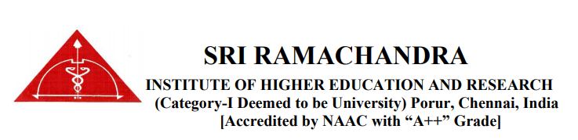
A STUDY TO INVESTIGATE THE POTENTIAL ASSOCIATION OF INTERLEUKIN-2 RECEPTOR B GENE (IL-2R b) WITH RISK OF ENDOMETRIOSIS IN INDIAN WOMEN (FIRST INTERNAL ASSESSMENT)
Reg. No: B0118022
B0118024

Slide 2
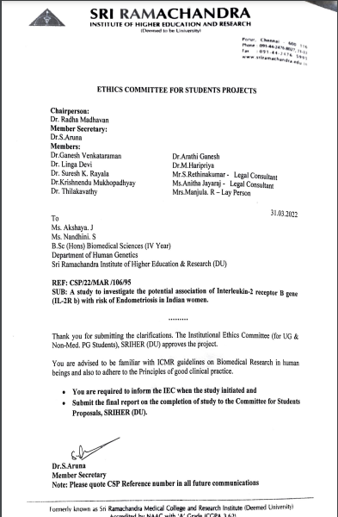

Slide 3
INTRODUCTION
Endometriosis
Endometriosis occurs when tissue similar to the lining of the uterus (womb) grows outside of the uterus.
The name of this condition comes from the word "endometrium," which is the tissue that lines the uterus.
Interleukins, also known as IL are a type of cytokine that were initially thought to be produced only by leukocytes
Function of interleukins is to modulate growth, differentiation, and activation
Interleukins often influence other interleukin synthesis and actions
Interleukin-2 (IL-2), binding with the specific interleukin-2 receptor (IL-2R) is due to the stimulating action
Stage 1: Minimal
Stage 2: Mild
Stage 3: Moderate
Stage 4: Severe

Slide 4
REVIEW OF LITERATURE
 | Name of the Author, Place of the study | Method of study | No. of cases and controls/ participants | Description | Findings
1 | Gyoung Hoon Lee et al, Korea, 2009 | Case - Control | Cases -237 Controls -164 | Polymorphism of the IL-2R b was assessed using the TaqMan allelic discrimination assay. | The C627T polymorphism of the IL-2R b gene may not be associated with the risk of endometriosis in the Korean population.
2 | Xue-Min Qiu et al, China, 2019 | Case - Control | Cases -28 Controls -12 | The levels of cytokines in PF were detected by CBA assay | Co-culture of ectopic macrophages and ESCs led to the secretion of an increased amount of IL-27 to enhance IL-10 expression, as well as IL-2 to control the continuous increase of IFN-γ production by T cells, which is expected to contribute to the high levels of IFN-γ and IL-10 at the advanced stage of endometriosis.

Slide 5
AIM AND OBJECTIVE
AIM
To investigate the association of interleukin 2 (IL-2) gene polymorphism related to risk of endometriosis.
OBJECTIVE
1. Identify the role of interleukin -2 (IL-2) gene polymorphism in endometriosis.
2. To compare the frequencies of interleukin -2 (IL-2) polymorphism between the cases and control.
3. To estimate a relative risk in the study population.

Slide 6
MATERIALS AND METHODS
CONTROL SAMPLES
INCLUSION CRITERIA: Fertile women with regular menstrual cycle, women had normal vaginal deliveries, as well as no family history, clinical symptoms or diagnostic evidence of endometriosis
EXCLUSION CRITERIA: Women with past or present endometriotic lesions, cysts, PCOS, inflammatory disorders or gynecological disorders.
CASE SAMPLES
INCLUSION CRITERIA: Dysmenorrhea, pelvic pain, ectopic pregnancy and diagnosis of endometriosis was made on the basis of laparoscopic findings. Medical record of the patients will be referred to rule out abnormalities, infections and uterine abnormalities.
EXCLUSION CRITERIA: Patients with inflammatory bowel disease, pelvic inflammatory disease, urinary tract infection was excluded from study. Patients who are unwilling to participate in the studywere not included as well.

Slide 7
PCR PROGRAM
STAGES | No. of. Samples
Mild | 16
Moderate | 11
Severe | 3
S.N | STEPS | TEMP | TIME
1 | INITIAL DENATURATION | 94 C | 5 MINS
2 | DENATURATION | 94 C | 60 SECONDS
3 | ANNEALING | 55 C | 45 SECONDS
4 | EXTENSION | 72 C | 45 SECONDS
5 | FINAL EXTENSION | 72 C | 7 MINS
6 | HOLD | 4 C
Primer Sequence
GENE | PRIMER | SEQUENCE (5’ – 3’) | LENGTH
Interleukin-2 | Forward | AAGGACACCATTCCGTGGCT | 20
 | Reverse | CCGGTGTTCCTGCAGTTGAT | 20

Slide 8
METHODOLOGY
30 CASE AND 30 SAMPLES WERE COLLECTED
ISOLATION OF DNA BY SALTING OUT METHOD
AGAROSE GEL ELECTROPHORESIS WAS DONE TO CHECK DNA QUALITY
DNA SEQUENCING WAS DONE.
STANDARD PCR WAS PERFORMED AND CONFIRMED BY 2% AGAROSE GEL
GRADIENT PCR WAS PERFORMED TO STANDARDISE THE ANNEALING TEMPERATURE

Slide 9
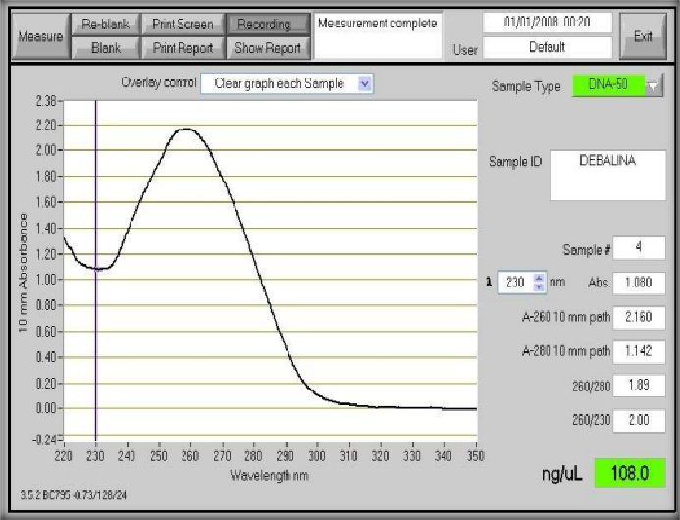
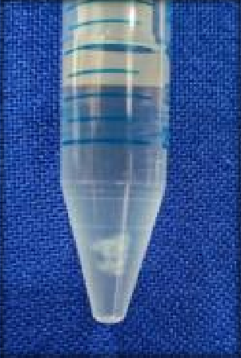
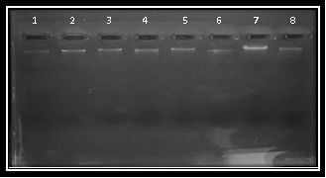
RESULTS
A
B
C
A - Isolated DNA
B - Quantitative analysis of DNA
C - Qualitative analysis of DNA

Slide 10
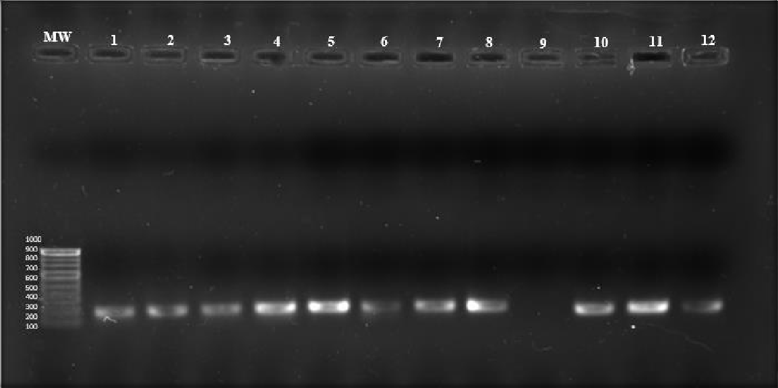
PCR Amplification of the DNA samples confirmed by 2% agarose gel electrophoresis
Lanes MW – DNA ladder 1-12 showing 167 bp amplicon in all samples

Slide 11
Genotypes observed in study
CC | Wild type
TT | Mutant
CT | Heterozygous

Slide 12
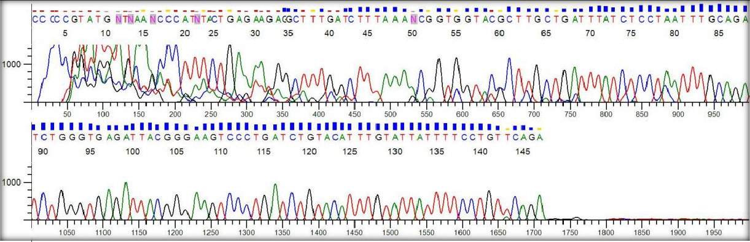
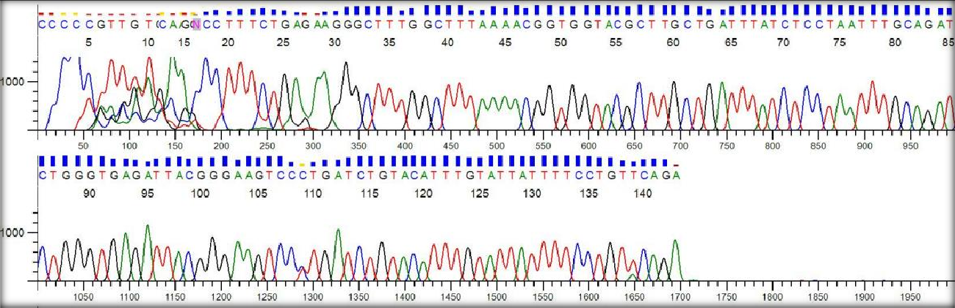
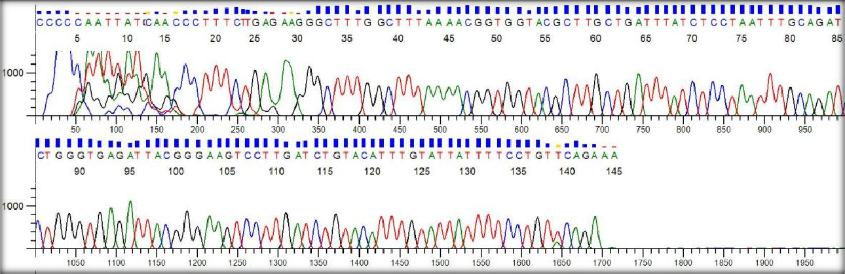
CC Genotype observed in the study
CT Genotype observed in the study
TT Genotype observed in the study

Slide 13
Genotype distribution of interleukin- 2 receptor beta gene (C627T) polymorphism in cases and controls
Interleukin- 2 Receptor beta gene(C627T) polymorphism |  | GENOTYPES |  |  | ALLELE FREQUENCY |  | P VALUE
 |  | CC | CT | TT | C | T
CONTROLS (n= 30) | Observed | 20 | 7 | 3 |  |  | 0.2308 (Non- significant)
 | Expected | 18.40 | 10.18 | 1.40 | 0.783 | 0.216
CASES (n= 30) | Observed | 20 | 8 | 2 |  |  | 0.6592 (Non- significant)
 | Expected | 19.2 | 9.6 | 1.2 | 0.8 | 0.2

Slide 14
Analysis of odds ratio and confidence interval of interleukin 2 receptor beta (C627T) gene polymorphism in cases and controls
Genotypes IL- 2Rb gene (C627T) polymorphism | Control (n= 30) | Case (n= 30) | Odds Ratio (OR) | Confidence Interval (CI) | P Value
CC | 20 | 20
CT | 7 | 8 | 0.96 | 0.34to 2.68 | 0.9445 (NS)
TT | 3 | 2 | 0.66 | 0.10 to 4.42 | 0.6747 (NS)

Slide 15
DISCUSSION
Several studies have identified retrograde menstruation in 90-99% of women of reproductive age.
Endometriosis is only seen in 1-6% of women with retrograde menstruation
Both environmental and genetic factors are found to play a role in developing endometriosis.
Several IL-4, IL-6 and IL-1 b polymorphism studies were reported to show no association with endometriosis
However, a study on 2005 showed an association between an IL-2R b polymorphism and endometriosis in Taiwanese women
C627T polymorphism in the IL-2R b gene was not associated with the risk of endometriosis.

Slide 16
CONCLUSION
In conclusion, we found that the IL-2R b gene C627T polymorphism is not associated with advanced stage endometriosis in an Indian population.
To the best of our knowledge, no study has looked into the relationship between the IL-2R b polymorphic loci and other complex diseases.
More research is necessary to determine the role of IL-2R b in the pathogenesis of endometriosis, as well as to confirm the possible association of the IL-2R b gene polymorphism with endometriosis susceptibility

Slide 17
BIBLOGRAPHY
Falconer H, D’Hooghe T, Fried G. Endometriosis and genetic polymorphisms. Obstet Gynecol Surv 2007;62:616– 628.
Hsieh YY, Chang CC, Tsai FJ, Hsu CM, Lin CC, Tsai CH. Interleukin-2 receptor beta (IL- 2R beta)-627*C homozygote but not IL-12R beta 1 codon 378 or IL-18 105 polymorphism is associated with higher susceptibility to endometriosis. Fertil Steril 2005;84:510– 512.
Salanti G, Sanderson S, Higgins JPT. Obstacles and opportunities in meta-analysis of genetic association studies. Genet Med 2005b;7:13 – 20.
Li M, Li C. Assessing departure from Hardy –Weinberg equilibrium in the presence of disease association. Genet Epidemiol 2008;32:589 –599.
Ellis K, Munro D, Clarke J. Endometriosis Is Undervalued: A Call to Action. Frontiers in Global Women's Health. 2022;3.
Wang XQ, Hu M, Chen JM, Sun W, Zhu MB. Effects of gene polymorphism and serum levels of IL-2 and IL-6 on endometriosis. Eur. Rev. Med. Pharmacol. Sci. 2020 May 1;24:4635-41.
Chapron C, Marcellin L, Borghese B, Santulli P. Rethinking mechanisms, diagnosis and management of endometriosis. Nature Reviews Endocrinology. 2019 Nov;15(11):666-82.
Andreoli CG, Genro VK, Souza CA, Michelon T, Bilibio JP, Scheffel C & Cunha-Filho JS 2011 Th1, Th2, and Th17 interleukin pathways participate in infertile patients with minimal/mild endometriosis. Fertility and Sterility 95 2477–2480. Bulun SE 2009 Endometriosis. New England Journal of Medicine 360 268–279.
Sampson JA. Peritoneal endometriosis due to the menstrual dissemination of endometrial tissue into the peritoneal cavity. Am J Obstet Gynecol 1927; 14:422-69.

Slide 18


